Slide 1
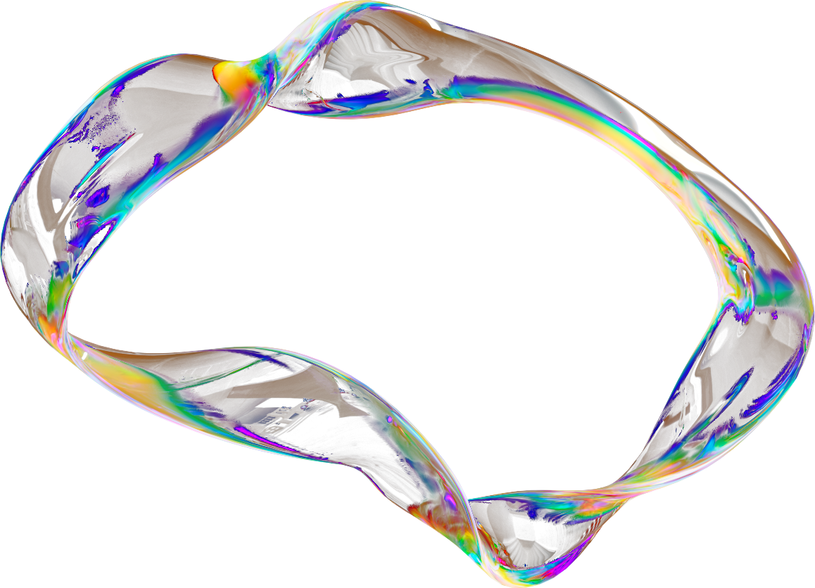


Joy Yahshua
PROJECT
AEGIS
AI Flood Alerting System
project-aegis.netlify.app

Slide 2
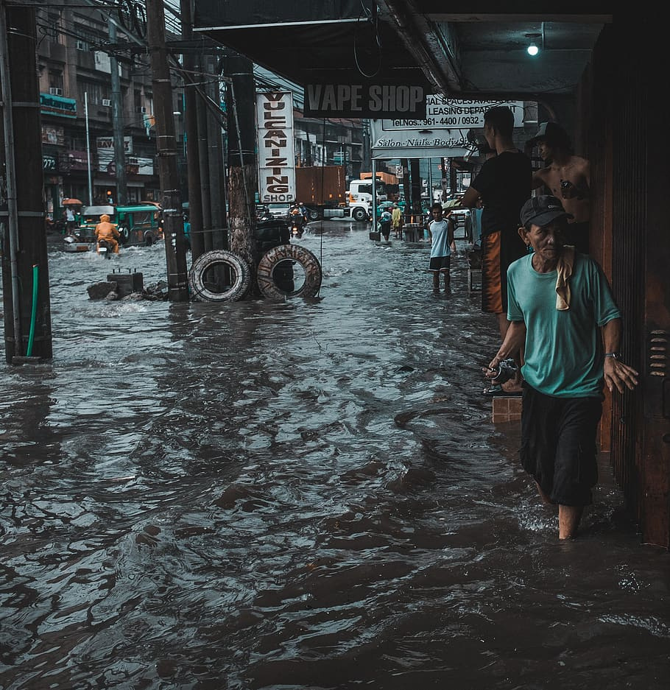

INTRODUCTION
Project Aegis is an AI-powered, multi-agent flood alert system designed to generate real-time, localized warnings for specific roads and regions. Built using CrewAI, the system leverages multiple specialized agents that collaborate to assess rainfall data, evaluate flood risk, and generate actionable alert messages.
By combining LLM-powered reasoning, real-time simulation, and a clean UI, Project Aegis provides a scalable foundation for smart disaster response—and sets the stage for broader applications like landslide or cyclone alerts

Slide 3


Lack of Real-Time, Localized Flood Alerts
Existing systems don’t provide hyper-local alerts (e.g., specific roads or streets), leading to delayed or irrelevant warnings
Manual Monitoring is Slow & Inefficient
Disaster teams often rely on manual data analysis, which slows response time and increases the risk of missed alerts
PROBLEM STATEMENT
Public and Officials Lack a Unified Alert Platform
There’s no centralized system combining real-time data, AI decision-making, and a user-friendly interface for both citizens and authorities

Slide 4

OUR SOLUTION?
MINUTE LEVEL FLOOD ALERTS
AHEAD OF THE CURVE
A very precise level of flood alerts and suggestions based on your unique situation
Provides alerts before such a situation arises based on real-time rain levels,past history,road conditions and local terrain.
SWIFT MESSAGING
PUBLIC DASHBOARD
We use sms messaging to alert our users and ensure everyone is saved even if they dont have our application.
A responsive, hosted dashboard (Netlify) shows real-time data in a clean UI, and acts as a tool for citizen and official access.

Slide 5
PROJECT
DETAILS
> Vision Board : ReactJS, vite, netlify.
> Protype : Streamlit
> AI Framework : CrewAI
> LLM Model : Gemini 2.5 flash/pro
> Agentic Pipeline : Meteorologist → Risk Analyst Agent → Alert Coordinator

Slide 6
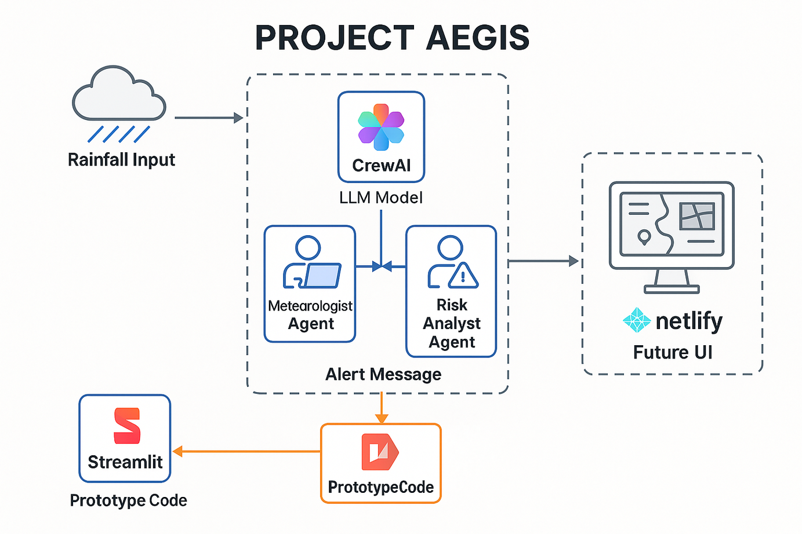
PROJECT ARCHITECTURE

Slide 7
Joy Yahshua
THANK YOU
for your time and attention
Project-aegis.netlify.app

